Slide 1

Function generator
SELF PROJECT
Aya Mohamed Sayed
Sec 1
B.No 9
Shubra faculty of engineering
Dr.Tarek Elewa

Slide 2

OUR TOPICS
Define what is function generator
The role of Function generator
Our circuit
Explain the circuit
Components
The breadboard of circuit
Function generator

Slide 3
WHAT IS FUNCTION GENERATOR
Definition: Function Generator is basically a signal generator that produces different types of waveforms at the output. It has the ability to produce waveforms such as sine wave, square wave, a triangular wave, sawtooth wave etc. An adjustable frequency range is provided by the function generator which is in the range of some Hz to several 100KHz
Function generator

Slide 4
THE ROLE OF FUNCTION GENERATOR
A function generator is a electronic device that can produce a variety of different waveforms. The one we will build can output square, triangle, or sine waveforms. Like standard function generators.
Function generator

Slide 5
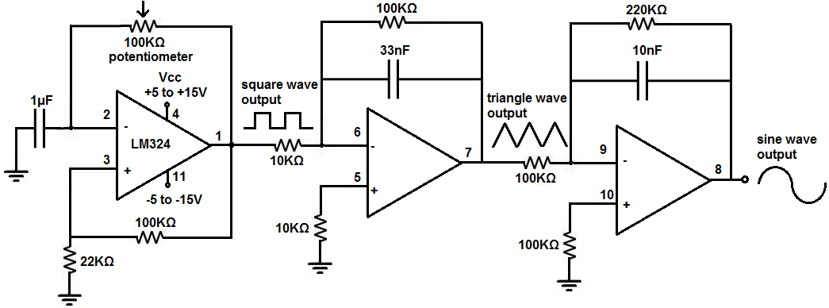
OUR CIRCUIT
The circuit works on the principle of just using op amps.
The LM324 is a quad op amp, meaning it's composed of 4 independent op amps.
In this circuit, the first op amp produces a square wave. After that, the circuit uses 2 integrator circuits to convert the square wave into triangle and sine wave signals.
Below we show how to build the circuit.
but in this circuit we modify some value of capacitors to generate the signals accuratly
Function generator

Slide 6
OUR CIRCUIT WITH LM324
The LM324 is a quad operational amplifier IC that we use to build this integrator op amp circuit.
The LM324 is an 14-pin chip.
-The pinout is relatively straightforward.
The LM324 has 2 power pins, pins 4 and 11.
Pin 4 is the positive voltage power supply, VCC. To this pin, we connect the positive voltage. This establishes the positive DC voltage rail for the circuit.
Pin 11, labeled GND, is the negative voltage power supply. To this pin, we connect the negative voltage. This establishes the negative DC voltage rail for the circuit.
Through these 2 pins, we establish the positive and negative DC rails from the AC signal can swing.
The LM324 can take in a maximum of up to 30V to pin 4, VCC.
All of the other 12 pins of the LM324 are the inputs or output of each of the operational amplifiers
Function generator

Slide 7
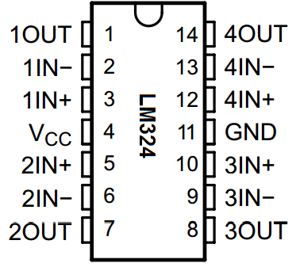
OUR CIRCUIT WITH LM324
There are 4 operational amplifiers within the chip. Each op amp has 2 inputs and 1 output.
On the pinout above, the op amps are labeled 1, 2, 3, or 4.
The 2 inputs for each op amp are labeled IN- or IN+. The IN- pin refers to the inverting terminal of the op amp. The IN+ pin refers to the noninverting terminal of the op amp. The OUT terminal refers to the output of the op ap.
And this is breakdown of the LM324 chip.
Function generator

Slide 8
OUR CIRCUIT WITH LM324
Our Components
LM324 op amp chip
1 10KΩ resistors
4 100KΩ resistors
3 22KΩ resistor
300KΩ and 560KΩresistor
0.1μF and 0.0 1μF ceramic capacitor
100KΩ potentiometer
Function generator

Slide 9
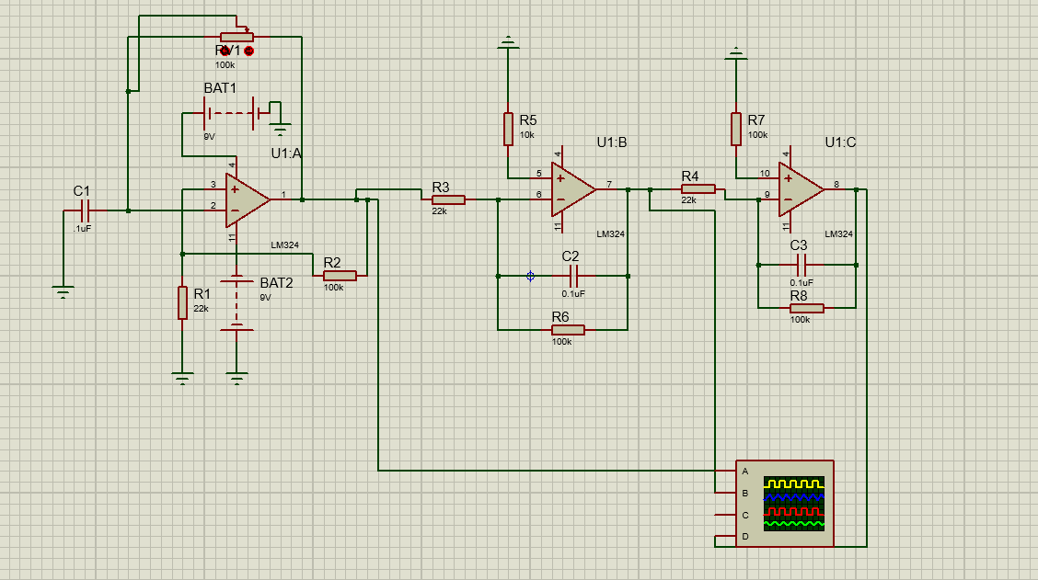
FUNCTION GENERATOR CIRCUIT BUILT WITH AN LM324 CHIP
The function generator circuit we will build with an LM324 op amp chip is shown below
Function generator

Slide 10
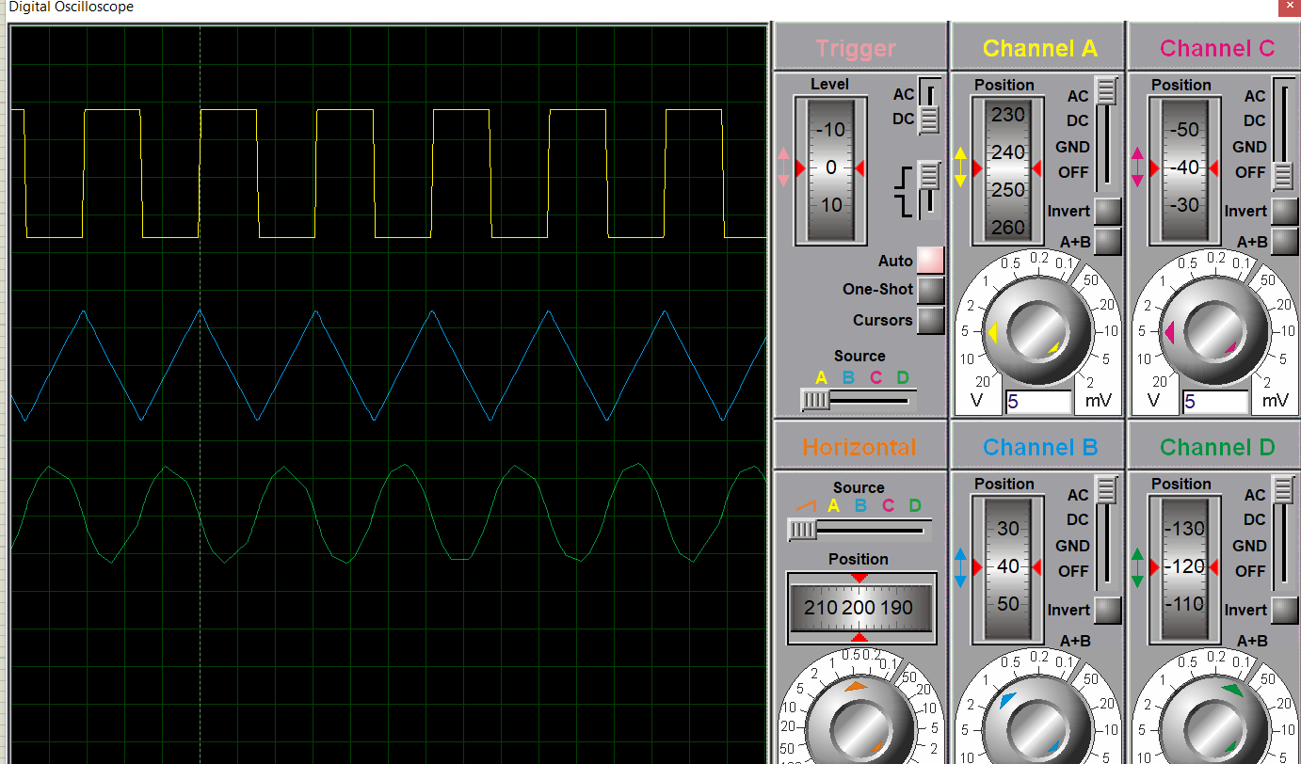
FUNCTION GENERATOR CIRCUIT BUILT WITH AN LM324 CHIP
The function generator circuit we will build with an LM324 op amp chip is shown below
Function generator

Slide 11
EXPLAIN OUR CIRCUIT
So the first concern is power to the circuit.
As explained above, the LM324 is powered by DC voltage through pins 4 and 11.
We feed anywhere from 5 to 15V into pin 4, VCC, and we feed anywhere from -5V to -15V to pin 11, GND.
This establishes sufficient power to the circuit so that it can operate.
So we have our first op amp. This op amp produces a square waveform. The 100KΩ potentiometer allows us to vary the frequency to the circuit. And it's the way of adjusting the frequency of the output signal.
So after the first op amp, we have a square waveform. What follows next is an integrator circuit. When you feed a square waveform into an integrator circuit, the output is a triangle waveform.
So after the second op amp, we now have a triangle waveform, as our second waveform.
We then feed this triangle waveform into another integrator circuit. When you feed a triangle waveform into an integrator circuit, the output is a sine waveform.
So after the third op amp, we have a sine waveform. This is our third waveform.
So this circuit is pretty basic. The first op amp produces a square wave. We feed this square wave into an integrator circuit, which outputs a triangle wave. We then feed this triangle wave into a second integrator circuit, which outputs a sine wave.
Function generator

Slide 12
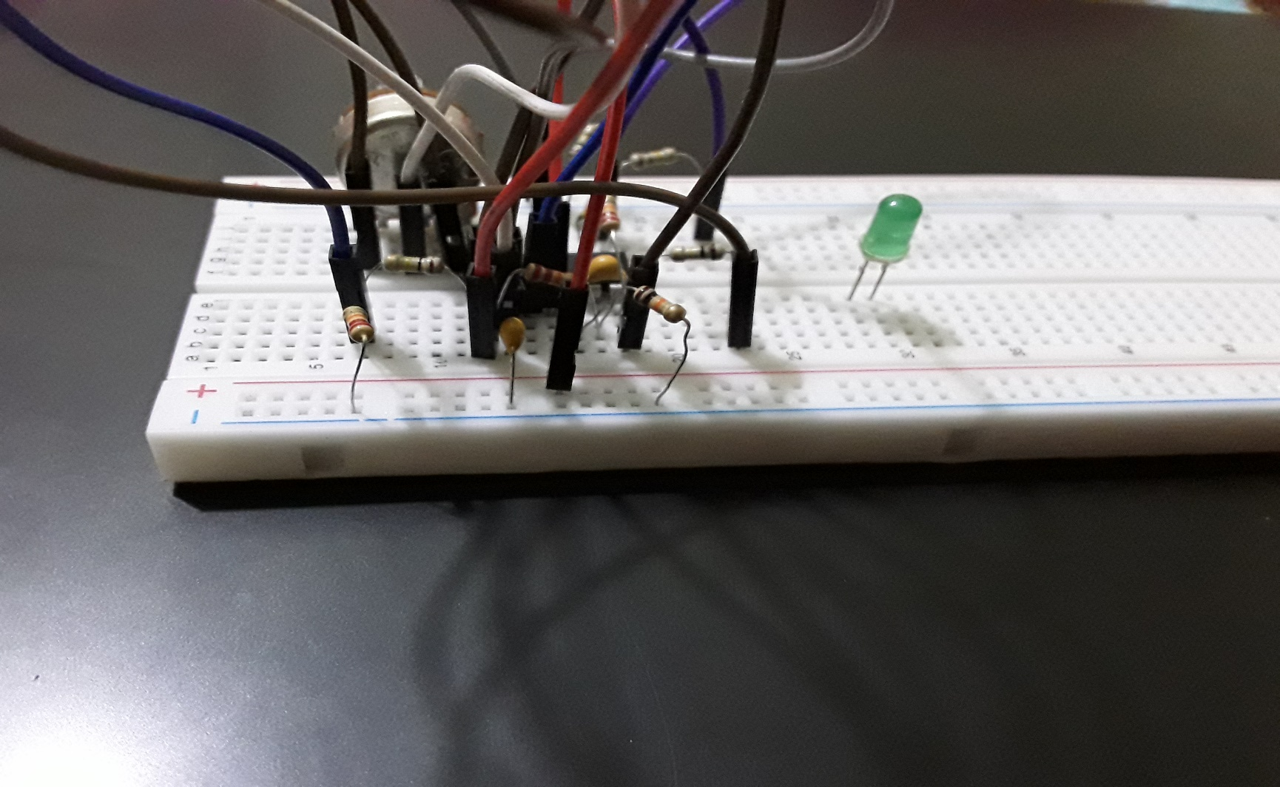
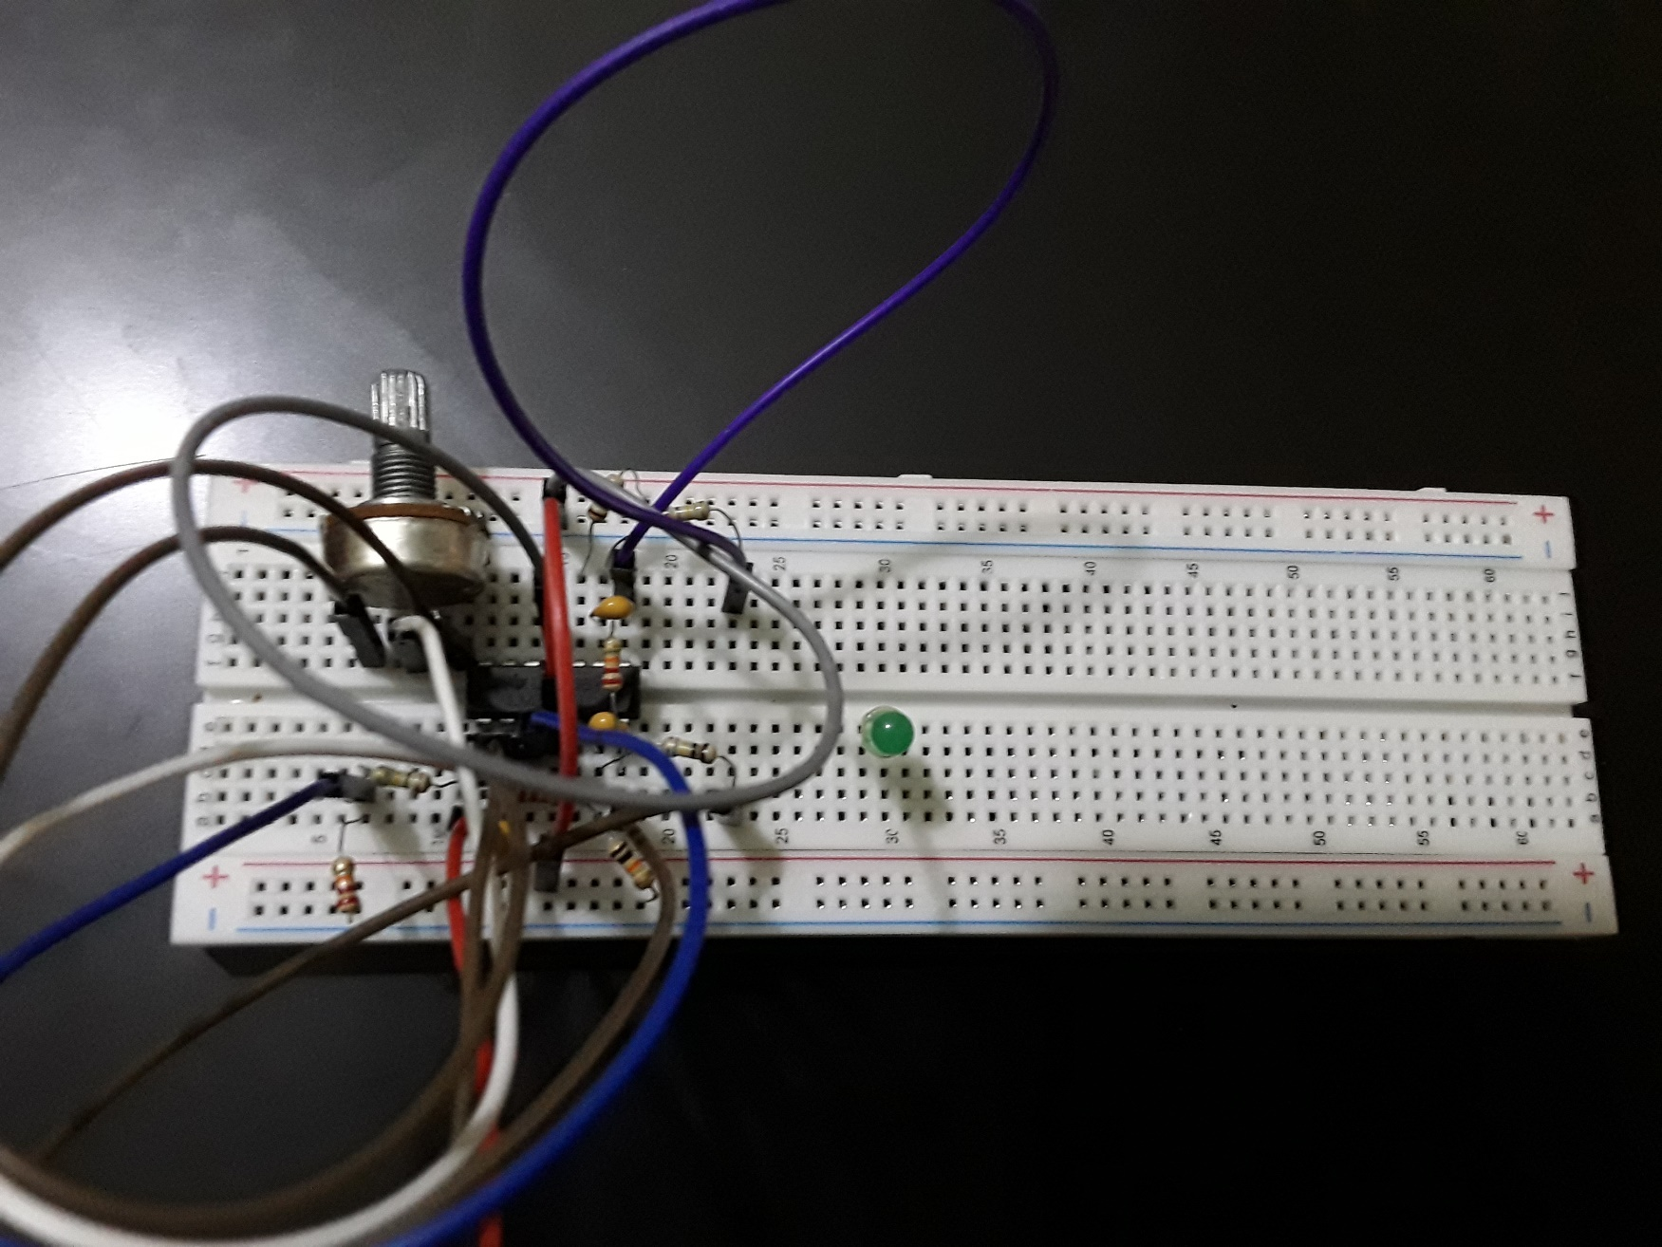
FUNCTION GENERATOR CIRCUIT BUILT WITH AN LM324 CHIP,THE BREADBOARD
The function generator circuit we will build with an LM324 op amp chip is shown below
Function generator

